Slide 1


GOOD READS
ETL PIPELINE
JUSTICE OHENE AMOFA

Slide 2
01
PROJECT OVERVIEW
02
MY ROLE
03
TECHNICAL CHALLENGES
04
SOLUTION APPROACH
05
RESULTS AND IMPACT
06
LESSON LEARNED
00
01
The Goals and Focus for the Project
Responsibilities in the building and setting up project
The various technical challenges with the project
Description and how the challenges was addressed
Results and impacts of the solution approach
Lesson and impacts on the results gained

Slide 3
07
ADAPTABILITY
08
TECHNICAL TOOLS AND TECHNOLOGY
09
CLOSING STATEMENT
10
REFERENCES
Adaptability to other approaches and results.
Tools and mediums used for the project

Slide 4

Project Overview
Goal : To Develop a real-time ETL pipeline for Goodreads data, enabling efficient data capture, storage, transformations, and analysis
Focus : Implementing an automated, scalable solution using Apache Spark, Apache Airflow, AWS S3 and Redshift
01

Slide 5
My Roles
01
02
03
Designing and Implementing the ETL pipeline.
Setting up and configuring AWS infrastructure (S3, Redshift, EMR)
Writing and scheduling ETL jobs in Apache Airflow.
04
05
06
Ensuring Data Quality and Integrity through validation checks.
Performing performance tuning and scalability testing.
Identify and resolving technical issues within the ETL pipeline.
02

Slide 6

About the
Project Concept

Slide 7
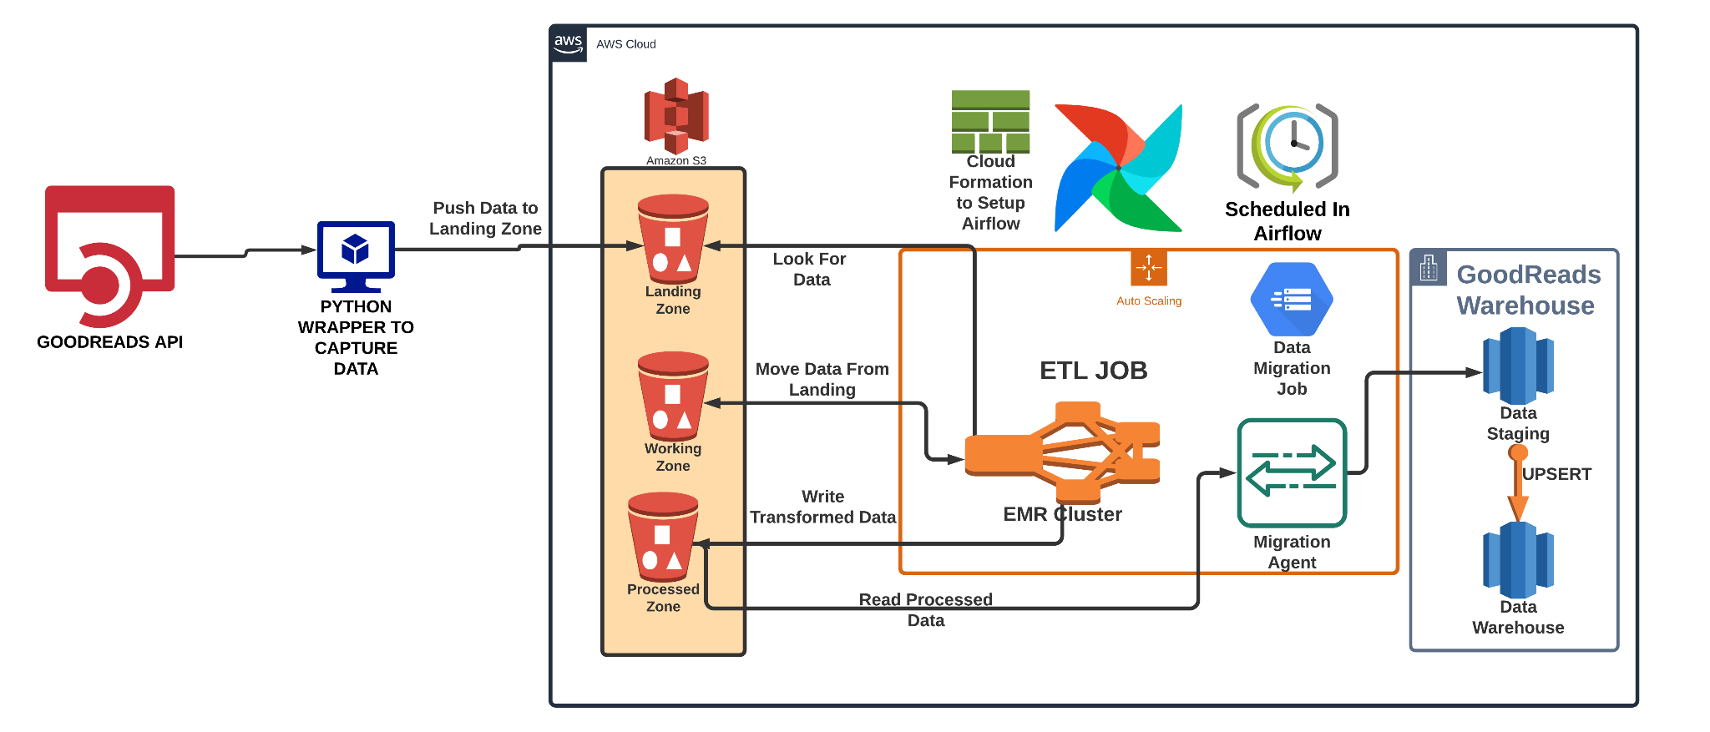
Concept of Solution
03

Slide 8

Technical Challenges
Real Time Data Capture from the Goodreads API.
Efficiently Managing Large Volumes of data in S3.
Optimizing Sparks Jobs For performance
Ensuring smooth data transfer between S3, EMR and Redshift.
Implementing robust data quality checks and error handling.
04

Slide 9

Solution Approach
Developed Modular ETL Jobs to handle each stage of data processing.
Automated data transfer and transformation processes.
Implemented data quality checks at multiple stages.
Conducted Scalability testing using synthetic data.
05

Slide 10

Results and Impacts
2.
Efficient handling of large data volumes
(up to 1.6 TB/day).
1.
Successful implementation of real-time ETL pipeline.
3.
Enhanced data analysis with fast query performance in Redshift.
06

Slide 11
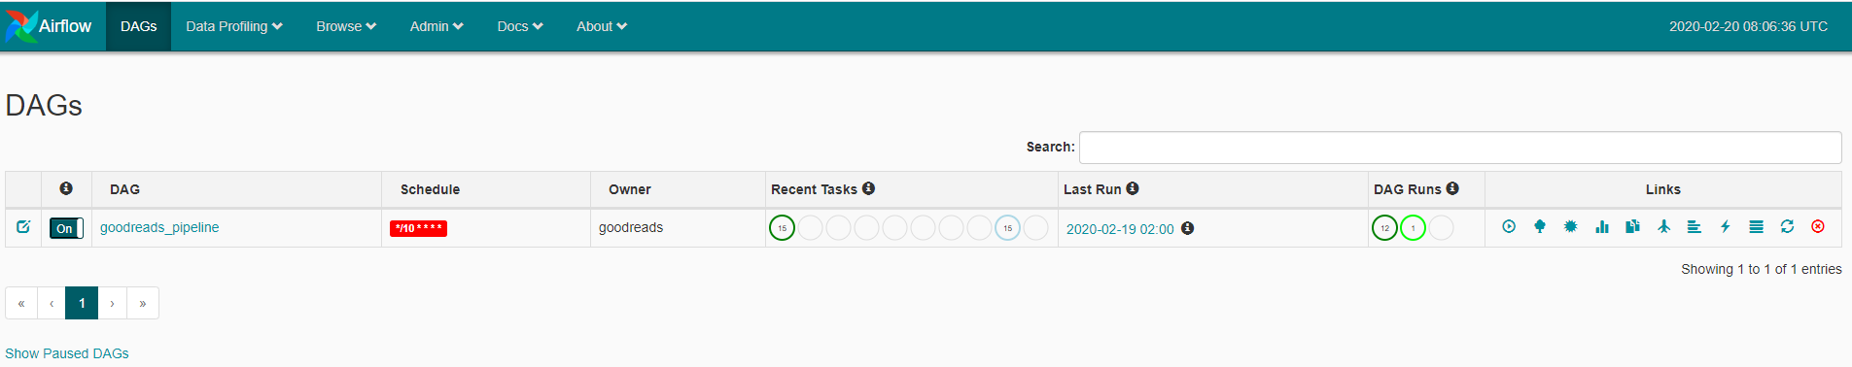
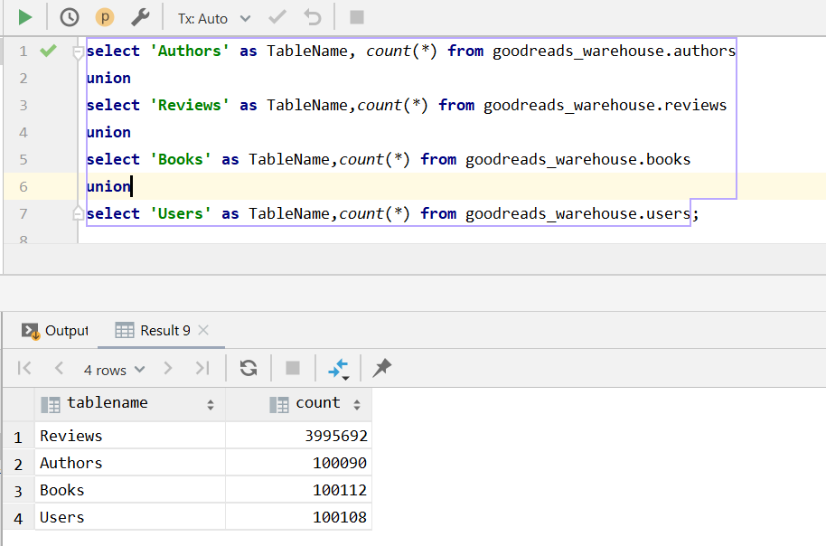
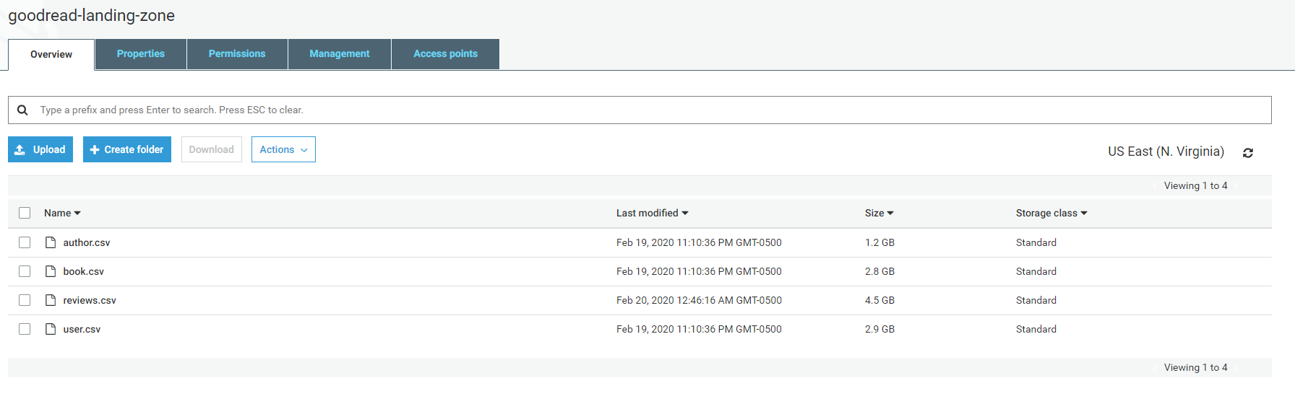
Results

Slide 12

Lesson Learned
Importance of thorough planning for the ETL processes.
Need for robust error handling and data quality checks.
Value of automation in managing large-scale operations.
Continuous performance tuning and monitoring are essential for maintaining efficiency.
06
07

Slide 13





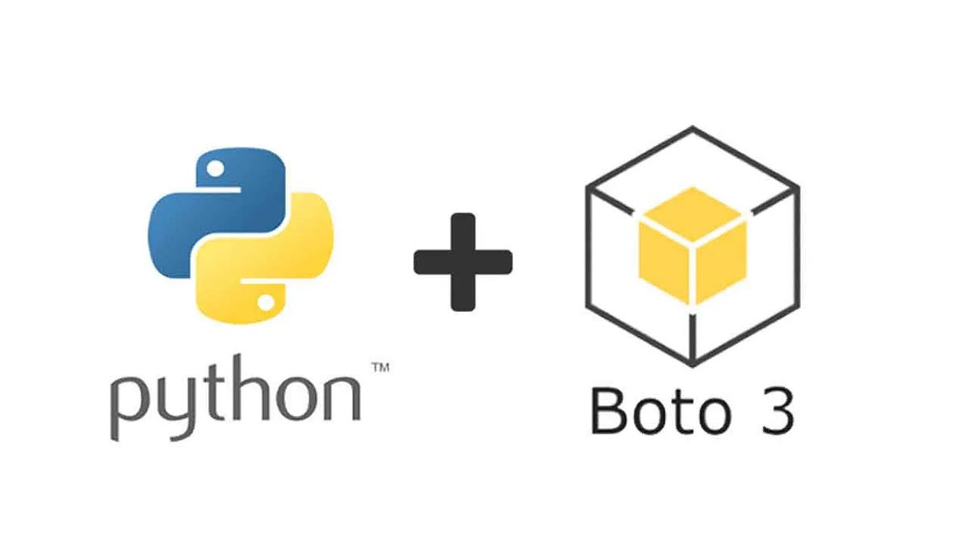

Technical Tools
And Requirements
Goodreads API: Real time Data capture
AWS S3: Scalable and data storage
Apache Spark: Data Transformation and processing.
Apache Airflow: ETL job scheduling and Orchestration.
AWS Redshift: Data Warehousing and Analytics.
Python: Scripting and automation
Boto3: AWS SDK for python used for S3 operations.
Psycopg2: PostgreSQL adapter for python used for Redshift.
08

Slide 14

Closing Statement
Demonstrated ability to handle complex data engineering challenges.
Proven expertise in using a variety of tools and technologies to build scalable, efficient ETL pipelines.
Effective collaboration and adaptability in evolving project requirements.
Commitment to ensuring data quality and integrity throughout the process.
09

Slide 15




Sponsors and Acknowledgements
Special Thanks To Facilitators and Organizers: Derek Degbedzui ,Wonders Aggor and All other Staffs
10

Slide 16

THANKS!
Do you have any questions?
Follow the project updates
Joamofa@st.ug.edu.gh
https://github.com/iamamofa/Final_project_Justice_goodreads_etl_pipeline

